Slide 1

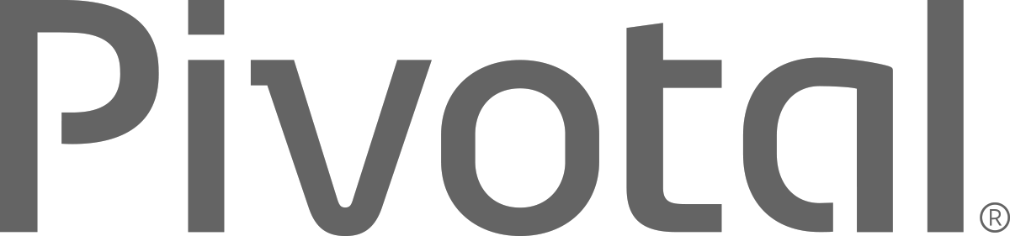
Introduction to
Pivotal Cloud Foundry
Ben Bertka / Platform Architect
bbertka@pivotal.io
@P3Geek
Notes:
Why we are here and what we are doing

Slide 2
Agenda
Changing Development Models
Cloud Native Application Platforms
Pivotal Cloud Foundry
2
Notes:
I wanted to go over some of these emerging development models and
how tech companies have been successful in moving to these highly composable, resilient application architectures that we’re referring to as cloud native applications.
I want to show you what kind of platform tools the leading tech companies had to build.
And how these new designs are really hitting a lot of enterprises, companies that don’t depend on software directly.
We also want to showcase how these projects work together with a demo of a microservice-based Java app, built with Spring Boot and Netflix OSS projects
Before we turn it over to discussion

Slide 3
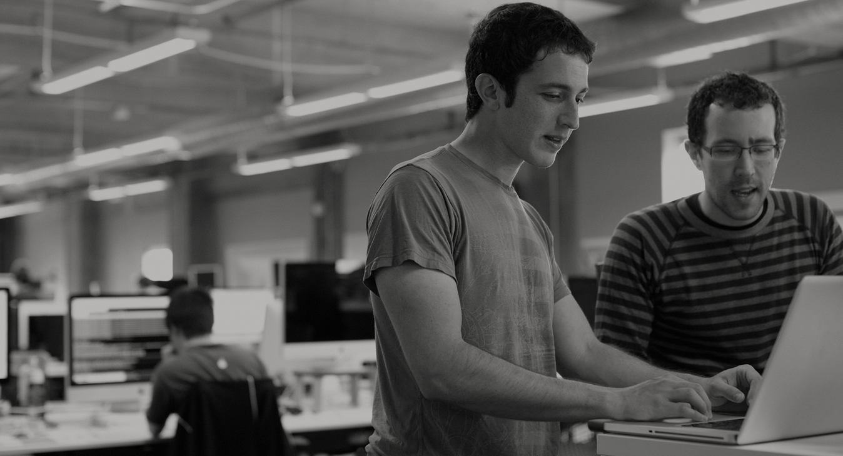

WE BELIEVE
Transforming how the world builds software will shape the future.
Notes:
At Pivotal, we believe Transforming how the world builds software will shape the future.
This is our core guiding principle that shapes our product and corporate strategy. Our success today is your success five years from now. With the ever expanding innovation gap between companies stuck with the status quo, and those companies pivoting with new practices and technology gaining the market, staying competitive means transforming at the core of the business, and in today’s world this core is not just the technology that runs the datacenter anymore, rather its the software development loop that cradles the market innovations, and the operations loop which enables innovation to flow freely. Achieving agility in dev and ops is the keystone to success in a rapidly growing technology space increasingly dominated by lean startups.

Slide 4
DevOps
Continuous Delivery
Microservices
Not my problem
Separate tools, varied incentives, opaque process
Release once every 6 months
More Bugs in production
Tightly coupled components
Slow deployment cycles
Shared responsibility
Common incentives, tools, process and culture
Release early and often
Higher Quality of Code
Loosely coupled components
Automated deployments
Notes:
Ensuring that you are set up to support new (changing) dev patterns with architectural and operations patterns that support "cloud native"; does your deploy velocity match your build velocity?

Slide 5
Developers Spend Time NOT Writing Software
Design and Coding
Brainstorming
Administrative tasks
Managing Environments
Waiting for Test/Build
Average Hours/Week
17.5 hrs ~ 40% of full work week!
Sources: “Electric Cloud LinkedIn Survey to software developers”
Notes:
What are the major contributors to developer downtime?

Slide 6
IT Ops Spends Time Building Snowflakes
IT Operations on a Cloud Native Platform
Request VMs
Request Network
Request Software Install
Request Database
Random Network Troubleshooting
14
0
0
4
0
4
8
DAYS
0
0
6
0
15
Nearly 6 months later
11
30
15
0
0.02
2
40
0.02
60
Random Middleware/OS Troubleshooting
Develop App
User Acceptance Testing
QA/Production Deploy Pipeline
Scale Up/Down
Need to Innovate Here
Notes:
What is your process for standing up dev, test, and prod environments?
Is this relevant for their Market?

Slide 7
Cloud Foundry Helps Close the Innovation Gap
Key Performance Indicators for Market Leadership
Agile/Developer Productivity/TDD
Continuous Delivery
DevOps
Cloud-native App Design
Culture/Talent
Startups
DevOps, CD, Agile
Enterprise PaaS
Expectations
&
Efficiency
Innovation Gap
DIY Automation
IaaS
Traditional IT
Time

Slide 8
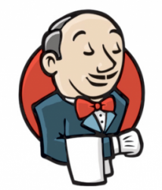
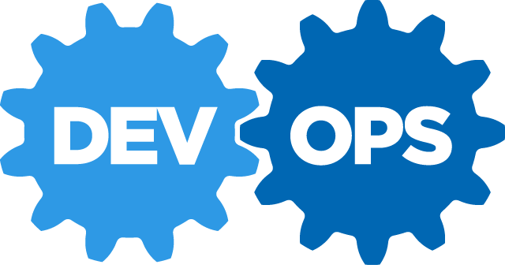
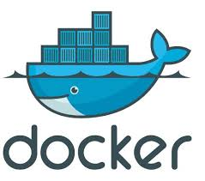

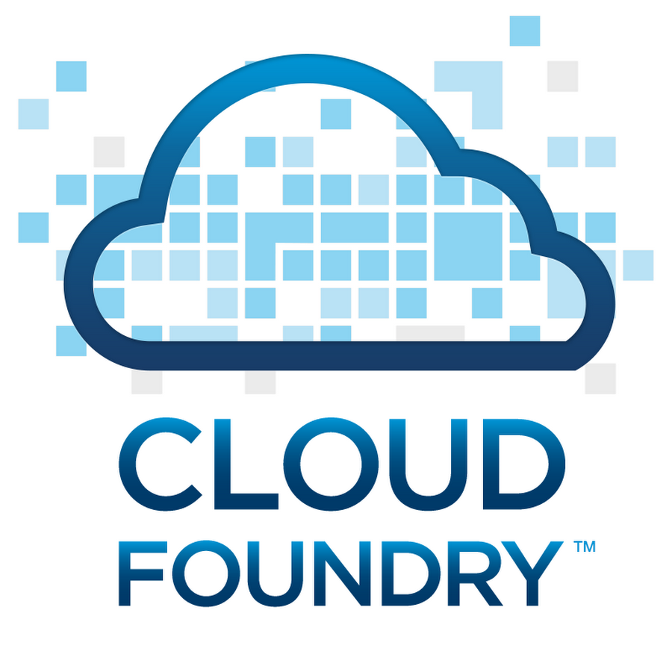
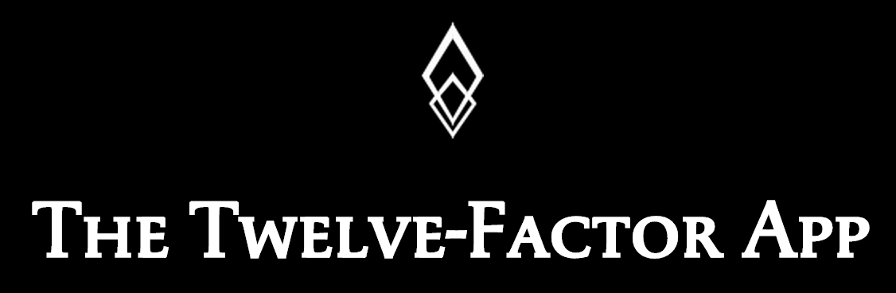

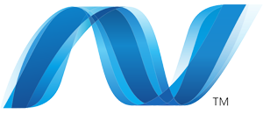
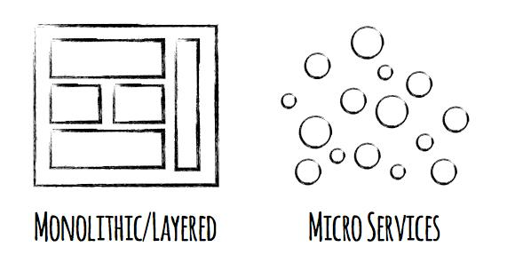
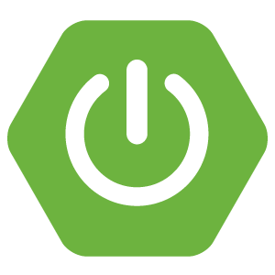

Software is EVOLVING
Continuous Delivery
Spring Boot
Notes:
Software is changing industries but software itself is changing. You hear a lot about buzz-words and new technologies coming to play with ideas such as Microservices, DevOps, Continuous Delivery and of Containerization of workloads made popular by Docker.
Being a modern developer is challenging because it requires constantly updating ones knowledge and skills, but its also so exciting, because never before have we been able to get into the flow with less technical roadblocks.
By the end of today, youll be fluent in all these technologies.

Slide 9
Trend towards new Lightweight Architectures
MONOLITHIC/LAYERED
MICROSERVICES
Notes:
Enterprise companies in finance and telco industries are embracing microservice and cloud-native models.
There are new architectures emerging atop these lightweight app servers to address the scale, speed and safety: new ways of tackling cloud scale and speed to market. Microservices has emerged from the internet giants as such an alternative: a change in culture, organization structure and technology that allows teams to work more independently, and increase velocity. It’s a key part of cloud-native applications, which we’ll talk about shortly.
Microservices are both a cultural and organizational change as a change in how we design and implement systems.

Slide 10
Cloud Ready Poll
App upgrades require planned outage?
Apps are hard to scale up or scale down?
App downtime when pulling cables at random in the datacenter?
10
Notes:
If you answer yes to any of these questions, you need a platform
People with Cloud Foundry on the right infrastructure say No to each question

Slide 11
It Takes a Platform
An end-to-end structured platform makes resilient distributed App
best practices, a turn-key,
first practice
11
Notes:
Mention the opinionated platform.
Structured vs Unstructured.
The word platform is thrown around alot these days. You’ve probably heard the word PaaS a few times already – its become the word of the year already. However, lets make a distinction, structured platforms vs unstructured platforms.

Slide 12
Path to Full Stack Automation
Business Value, Agility & Cost Savings
Traditional IT
IaaS
Platforms
You Manage
Applications
You Manage
Applications
Applications
Data
Data
Data
You Manage
Runtime
Runtime
Runtime
Middleware
Middleware
Middleware
Pivotal CF
+
Choice of IaaS
O/S
O/S
O/S
Virtualization
Virtualization
Virtualization
Servers
Servers
IaaS
Servers
Storage
Storage
Storage
Networking
Networking
Networking
12
Notes:
How you you characterize your IT stack?

Slide 13





Building a Cloud Native Platform
Choosing a
Metrics
SSO
Data
Load
Balancing
CI/CD
Java/.NET
Microservices
Spring Boot
Netflix OSS
Developer AND
Operator Agility
True Multi-cloud
Portability
Pivotal Cloud Foundry
Elastic Container Runtime
DIY Tooling:
Puppet
Chef
Ansible
Cloud formation
Terraform
Rancher
…
OS
Container Orchestration
Cloud Orchestration
CPI
Azure
13
Notes:
Whata are you currently using for tooling?
Hella vs Wiked
SF vs Boston
True Multicloud portability

Slide 14
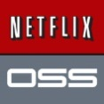
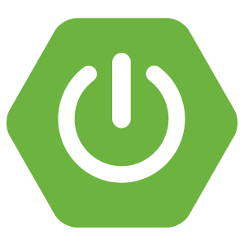
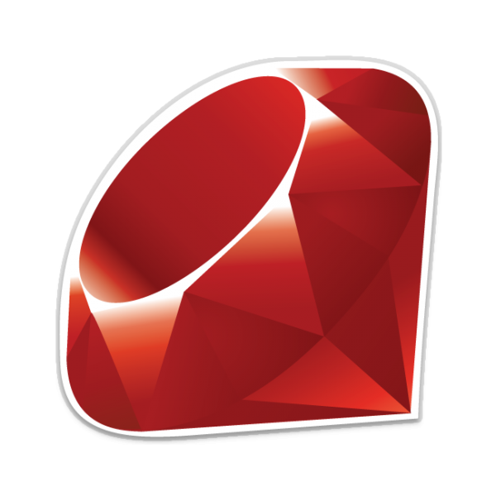


Cloud Native Platforms and Contracts
Culture
Framework
Tools
Application Framework
Netflix OSS, Spring, .NET, Ruby
Python, NodeJS, and more...
App Dev
Contract: 12 Factor App
Elastic Container Runtime
Pivotal
Cloud Foundry
PaaS Dev & Ops
Contract: BOSH Release
Infrastructure Automation
bosh.io
IT Ops
Contract: Cloud Provider Interface
Azure
Notes:
And all of this is enforced through strict API contracts that allow you to go FAST and be safe.
Last time we sat down we discussed at a high level what Pivotal provides, today I want to go a bit further into the capabilities of the platform along with its integrations and points of interoperability with external systems. Its important to note that Cloud Foundry is more than a tool, rather it is a cloud native platform, whereby the architecture is purpose built for running apps in the cloud, and itself is cloud agnostic, meaning you can run the same cloud foundry PaaS across any cloud provider. To achieve this, cloud foundry is first and foremost built for running mission critical applications and microservices at scale. It empowers developers by providing the flexibility of working with Docker images, .NET applications, Spring Java, and polyglot languages all within an environment that requires nothing more than a developer to provide code. To enable this, it takes a platform that OOB provides all the logging, APM, Data, High availability, routing, DNS, through an as-a-service approach, interfacing with the underlying infrastructure. That infrastructure can be any cloud provider, and through orchestration, and automation of IaaS functions, can stand up a cloud foundry install with ease. How does a system like this work together? It requires communication, not only between Dev and Ops, but through the layers of App, Platform, and Cloud. The applications run in a platform, abiding by a contract that they be purpose built for the cloud. With frameworks like Spring Boot an app can have profiles which reduce the amount of code to change compatibility with a runtime environment in local or cloud to just a configuration file. Following the best practices set forther by 12factor.net (Heroku), a developer can construct an app to be resiliant, use polyglot persistance, implement netflix battle tested patterns, and deploy configuration changes to an app non disruptivley. On the other side, the platform and onfrastructure itself if made robust through version control of runtime configurations. BOSH our infrastructure automation agent makes versioning your infrastructure configurations a breeze, at the same time keeps the HA of the platform running reliability at all times. To ensure cross cloud compatibility, the BOSH cloud provider interface (CPI) is implemented for the cloud provider’s api. These three things together, Application Framework, Runtime Platform, and Infrasrtucture automation are the key stones fo PCF.

Slide 15
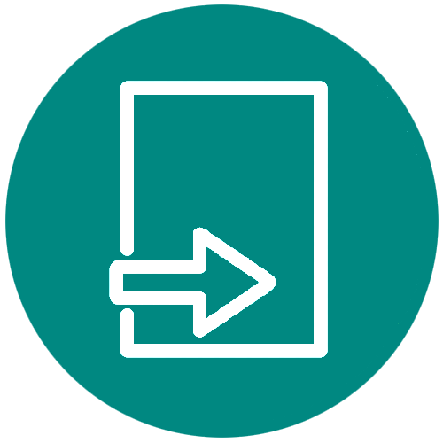
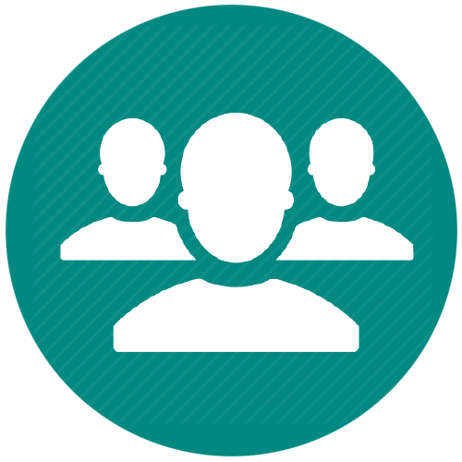
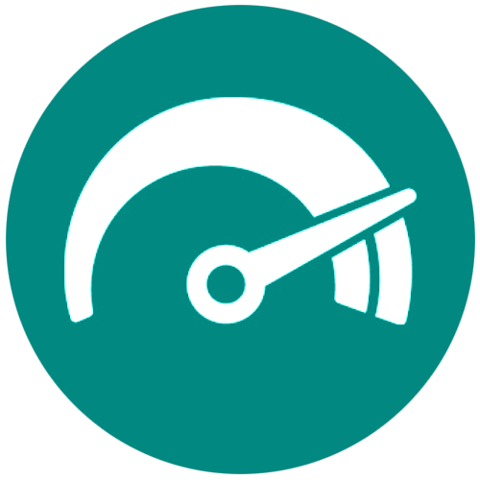

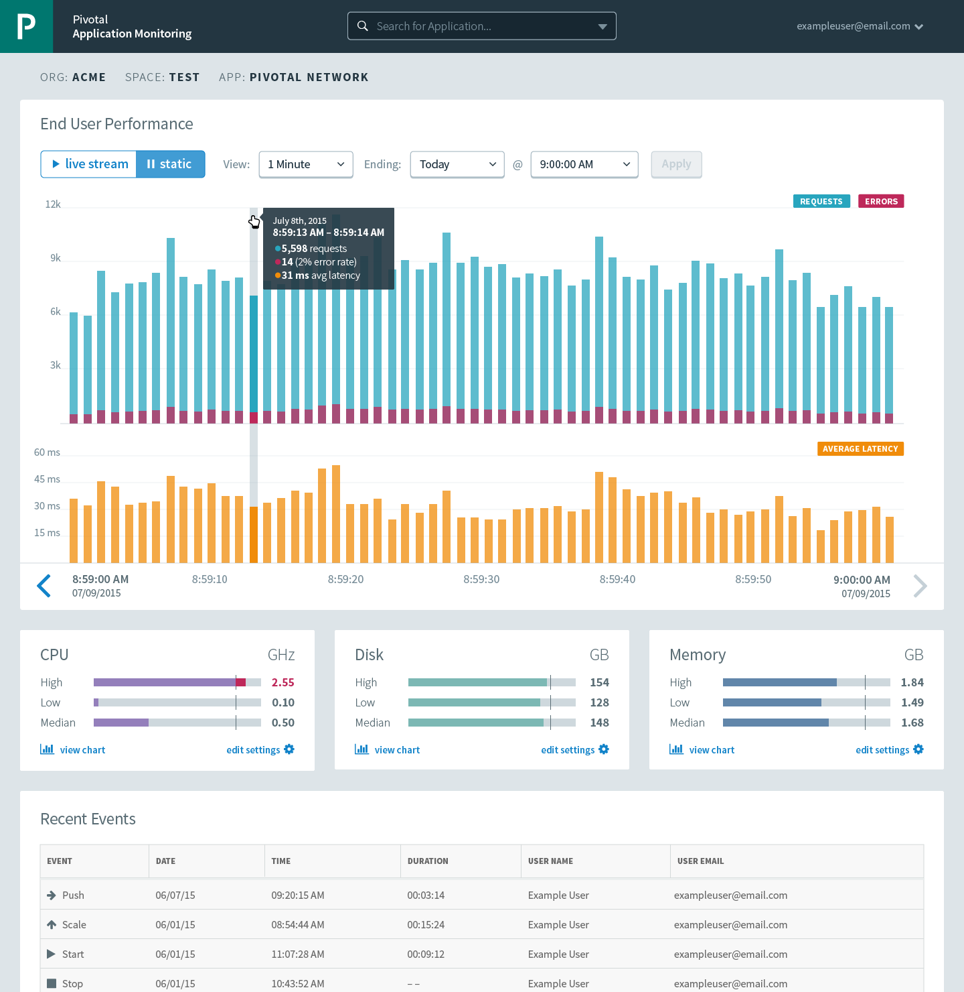
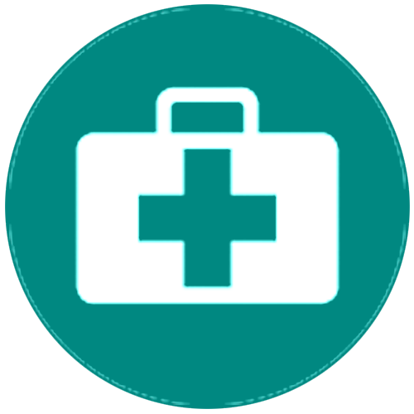
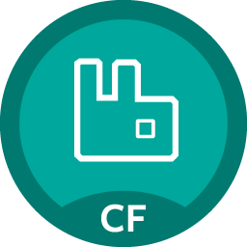
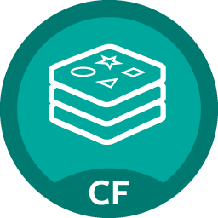
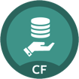
Cloud Foundry: An App-centric Platform
Roles & Policy
Centralized Log Management
Networking
& Load Balancing
Auto-Scaling
APM & Tracing
APPLICATION
Health management
Marketplace
Notes:
Tell me about your apps

Slide 16
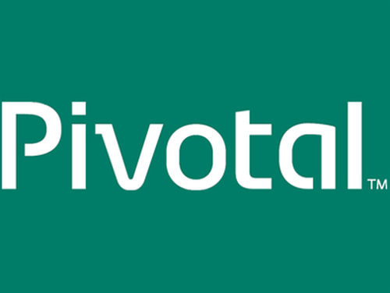

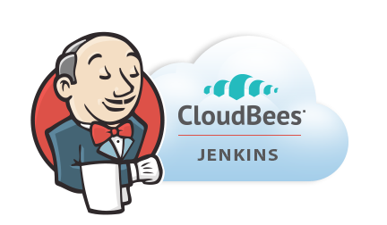
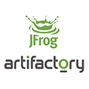
Application Lifecycle Management: CI/CD
AUTOMATION.
Integrate tools and automate processes from testing to builds and deployment.
SPEED.
Releasing more frequently with fewer bits will reduce complexity and improve time-to-market.
QUALITY.
Shorten feedback loop using test-driven development to surface problems sooner.
AGILITY.
Push updates on regular basis with no downtime to improve customer experience and time to market.
Commit Code Change
Automate Build & Test
Manage Binaries & Build Artifacts
Pivotal Cloud Foundry (Elastic Runtime)
Build Pipeline Operations
Gitlab
Jenkins
Develop, Test, QA and Production on the same platform.
Horizontal scaling, high availability, security, logging, update management
Built-in ecosystem of services.
Deploy, operate and scale on IAAS of choice.
Simple, developer friendly commands and APIs.
Tool Chain
Build, test and deploy software projects continuously and incrementally. Thousands of compatible plugins.
Distributed revision control and source code management. Collaborative software development.
Share binaries and manage distributions. Manage artifact lifecycle.
Notes:
Highlight here that if we had a Docker step for building images, we would add ~15 minutes to the process.

Slide 17
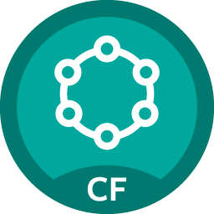
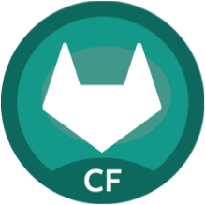
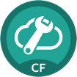
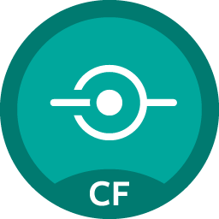
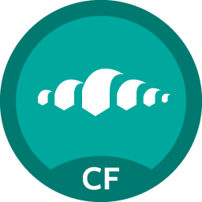
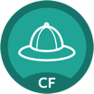
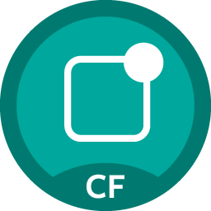
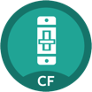
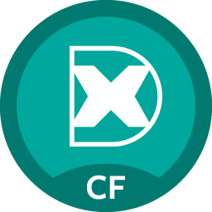
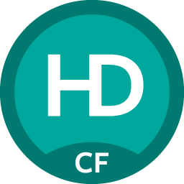

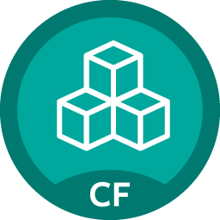
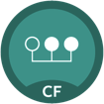
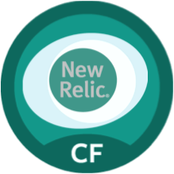
Fast, Self-service Provisioning
Mobile
Data
CI/CD
Cloud Native
DataStax Cassandra
Config Server
App Distribution
Redis
Git Lab
Jenkins Enterprise
Service Discovery
Push Notifications
MySQL
RabbitMQ
Monitoring
Circuit Breaker
Security
Data Flow
PivotalHD
App Dynamics
Single Sign-on
Session state caching
GemFire
Powered by
New Relic

Slide 18
Four Levels of Built-In High Availability
PCF
PCF
PCF
Zone 1
Zone 2
A
B
C
A
B
C
A
B
C
A
B
C
A
B
C
A
B
C
A
B
C
VM1
VM2
VM3
B
B
B
B
Runtime VM
3. Resurrector restarts failed VMs
Process
B
A
B
C
A
B
C
A
B
C
A
B
C
OS,
Mware
OS,
Mware
OS,
Mware
B
B
B
B
If an app fails, PCF reboots app in a new container.
If a process fails, PCF restarts the process
If an OS or network failure occurs PCF kills the VM and reboots the host in a new Virtual machine.
If a datacenter rack fails, PCF ensures applications stay running in multiple availability zones
App Fail
Process Fail
VM Fail
Rack Fail
Notes:
Application performance and reliability have a direct correlation to HA capability. Pivotal provides 4 level of HA so that you don’t need to invest in people/software to handle common failure situations. If an application fails, we will reboot it in a new container. This automated remediation addresses application bugs that result in outages. If a Pivotal process fails, we will reboot it in a new virtual machine. Our PaaS essentially monitors and remediates itself. If an OS or network failure occurs, our VM monitor will detect this and kill the VM, then reboot it in a new container. This streamlines Linux sysadmin operations. Lastly, if a datacenter rack fails, we will ensure the application stays running because we load application instances in multiple availability zones. No 2 availability zones live on the same datacenter rack. This hardware failure level resilience is very difficult to design using traditional tools provided by HP/CA/IBM.
And, by using Pivotal, you reduce the number of servers that require HP/CA/IBM monitoring tools.
http://blog.pivotal.io/cloud-foundry-pivotal/products/the-four-levels-of-ha-in-pivotal-cf
Desired State of Application is maintained by Cloud Controller. DEAs communicate status of their apps to Health Manager. HM checks with CC. CC restarts app in another DEA in case of failure
PCF Processes monitored by monit and restarted in case of failure
In case of VM failure. Health Monitor is notified. HM calls BOSH Director which calls Resurrector component which starts up the VM (with processes)
Availability Zones is a logical grouping of the deployment of System Components and DEAs. (Example would be two racks in a datacenter)

Slide 19
Pivotal Cloud Foundry at a Glance
Platform Runtime
Services
Routing
Container Scheduling
Service Discovery
Configuration
Database
Application Framework
Big Data
12 Factor Apps
Microservices
RESTful Services
Circuit Breakers
Object Storage
Mobile
Spring Boot
Ruby on Rails
Node.js
.NET
Build CI
User Provided
Logging & Metrics
Messaging
Operations
Zero Downtime Deployments
Failover & Recovery
Scaling
Security Patching
Platform
Upgrades
Azure

Slide 20
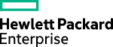
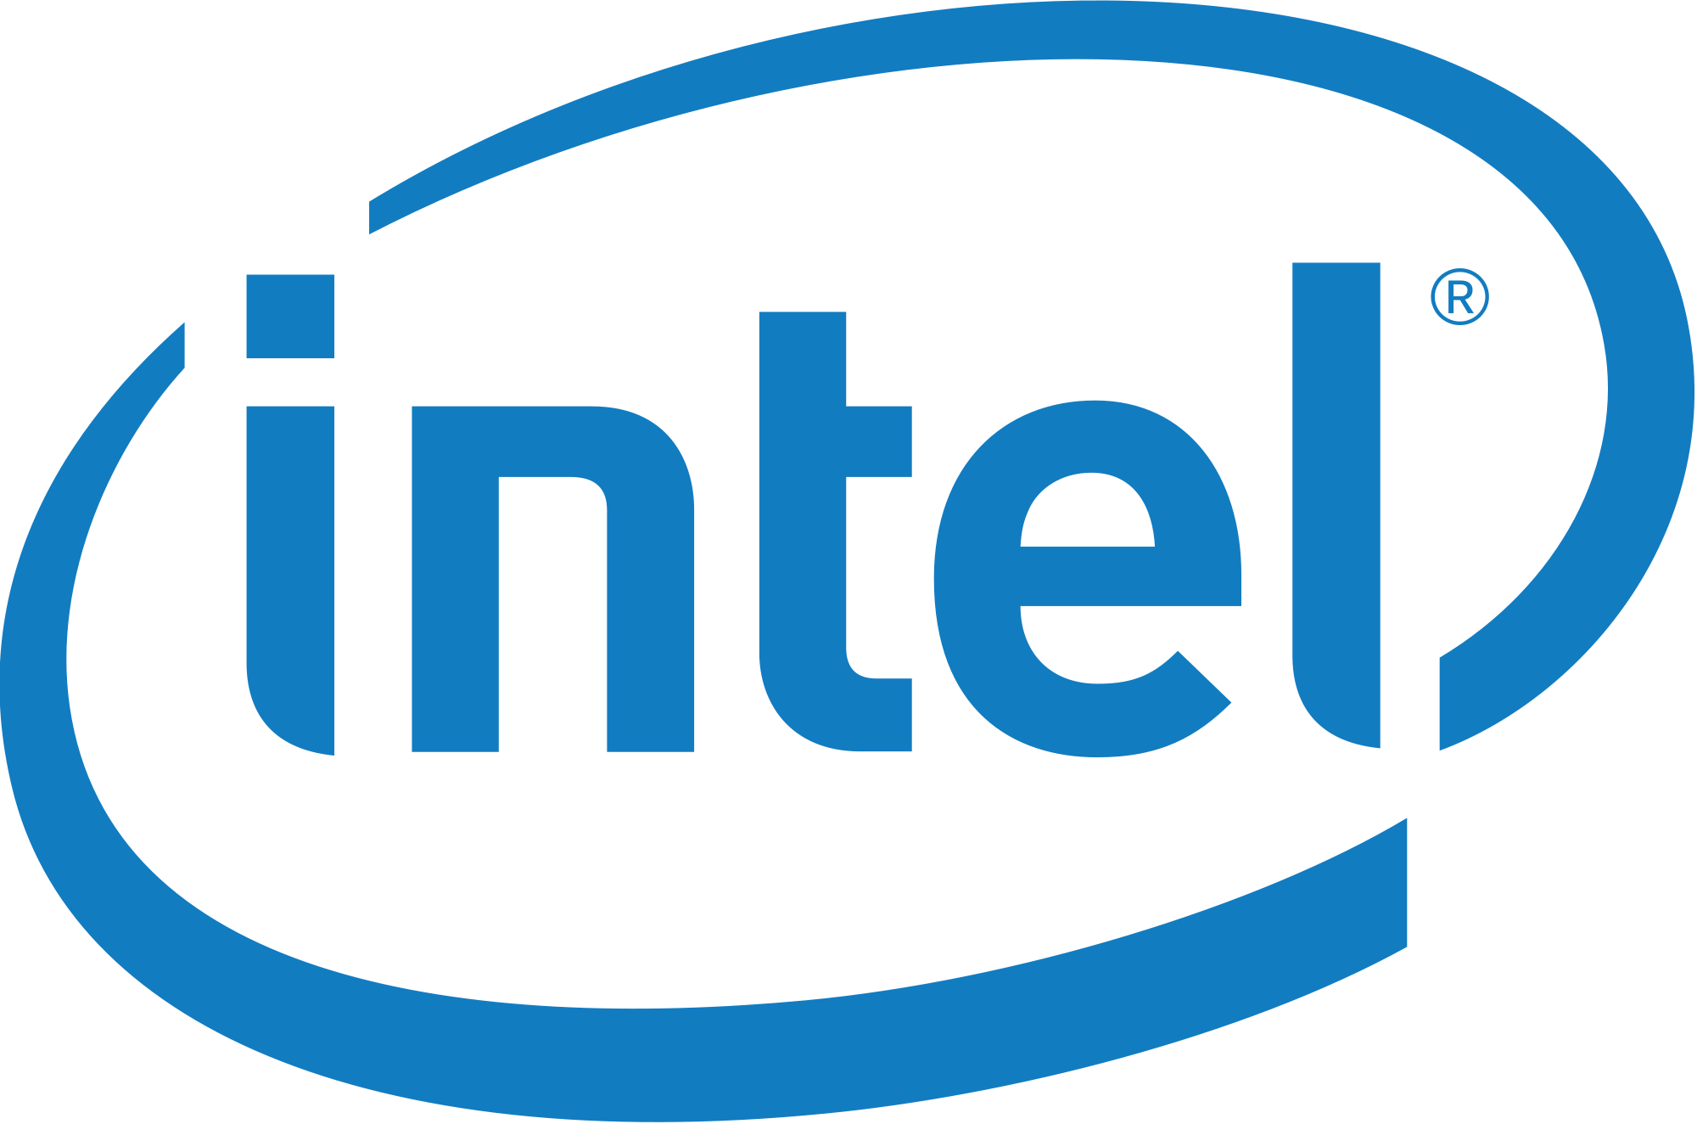
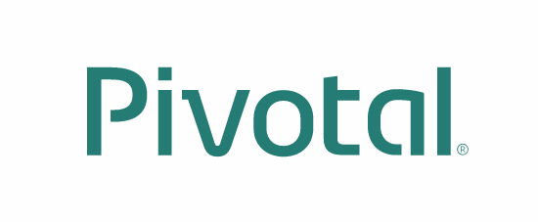
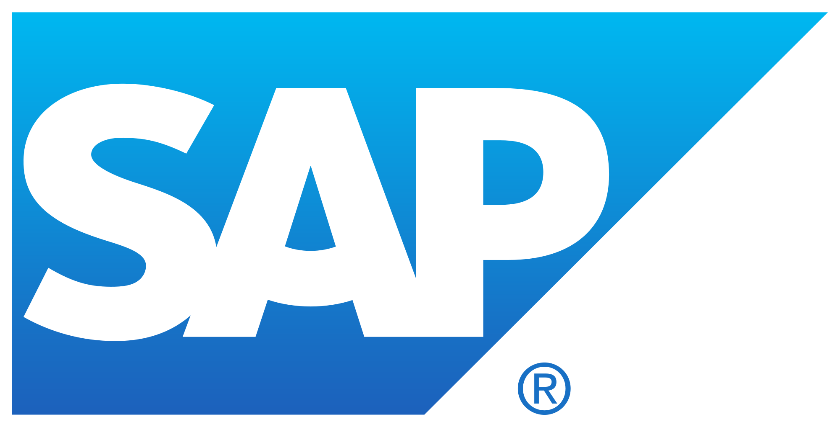
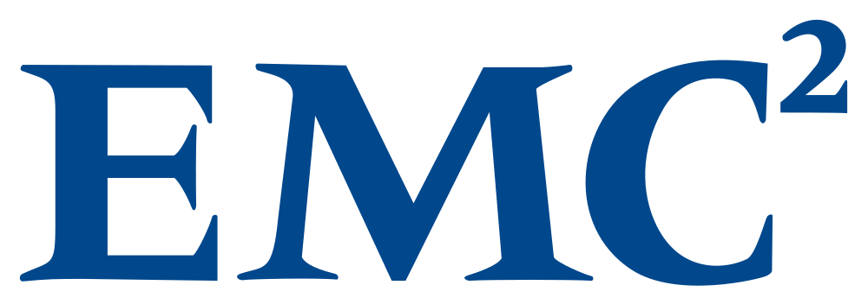
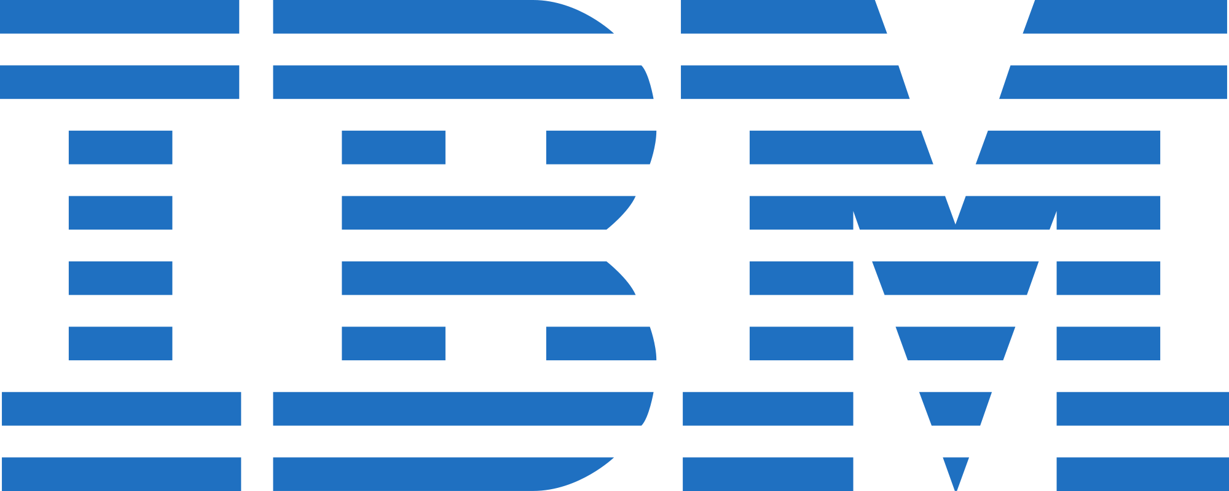
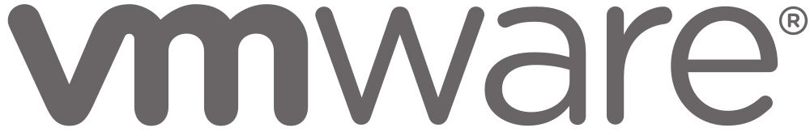

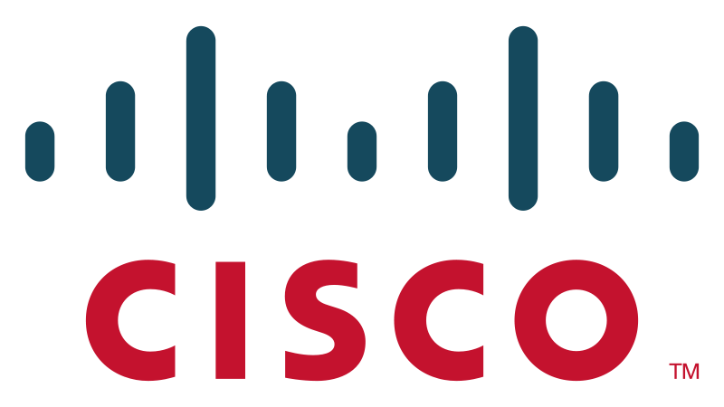




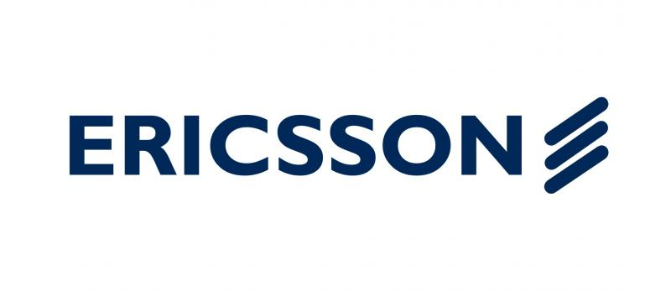
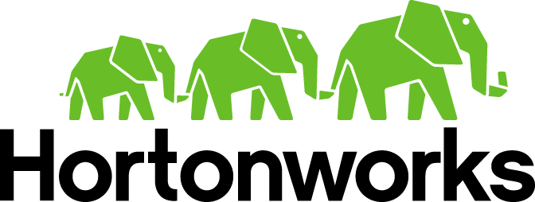

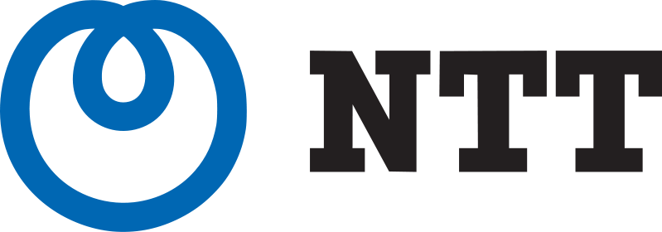
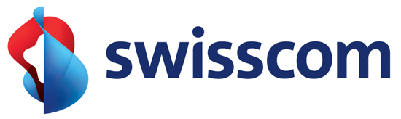
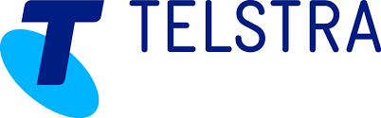


























Pivotal Cloud Foundry: Most Trusted Platform
PLATINUM
GOLD
SILVER
Notes:
Open source software offers true community-driven outcomes. Cloud Foundry Foundation has 40+ companies that participate in the community with a vested interest in a platform that continues to grow and meet customer needs, now and in the future.

Slide 21



Cloud Foundry Open Source MOMENTUM
Commits
Submitters
53 corporations are contributing members
158 meet-ups in 49 countries
21K members with ~5K joining last month
~2200 developers, ~650 Code Submitters, ~400 of them in last year
65K commits with ~30K of those in the last year
Source: http://cloud-foundry.meetup.com/ on Jun 12 2015

Slide 22




Customer Results
“App in 10 weeks instead of 9 months”
“From 2 months for provisioning servers to deliver product in less than 5 weeks”
“The lean, agile product development practice we’ve stood up in partnership with Pivotal labs is a vehicle for cultural transformation.”
“18 lines of code to get a database, messaging middleware and an app server - kind of amazing!”
“Experience really been positive. Helped us become more “T” shaped engineers”
Notes:
Pivotal is the fastest growing open source company in history.
We are getting some good results for our customers. We would love to work with you further.

Slide 23


D e m o
Notes:
Scale Demo – its the fastest to stage
Do not go too deep into all the features if PCF.
This is an application status overview, we can scale and show high availability
Then do Spring Music via Jenkins
Show Metrics
If time, show Splunk

Slide 24
Pivotal Cloud Foundry at a Glance
Platform Runtime
Services
Routing
Container Scheduling
Service Discovery
Configuration
Database
Application Framework
Big Data
12 Factor Apps
Microservices
RESTful Services
Circuit Breakers
Object Storage
Mobile
Spring Boot
Ruby on Rails
Node.js
.NET
Build CI
User Provided
Logging & Metrics
Messaging
Operations
Zero Downtime Deployments
Failover & Recovery
Scaling
Security Patching
Platform
Upgrades
Azure

Slide 25
EXTRA
25
Notes:
I wanted to go over some of these emerging development models and
how tech companies have been successful in moving to these highly composable, resilient application architectures that we’re referring to as cloud native applications.
I want to show you what kind of platform tools the leading tech companies had to build.
And how these new designs are really hitting a lot of enterprises, companies that don’t depend on software directly.
We also want to showcase how these projects work together with a demo of a microservice-based Java app, built with Spring Boot and Netflix OSS projects
Before we turn it over to discussion

Slide 26

Pivotal Cloud Foundry Business Model
Open source software provides the core platform runtime
Commercial distribution provides enterprise & production ready services, support, docs, certifications, and more…
Notes:
Our company may be young, but the codebase has developed over many years. Many of the original developers are still at Pivotal.
Cloud Foundry Open source software provides the foundation for the Pivotal Cloud Foundry platform. Commercial distribution provides enterprise services, support, docs, certs etc.
For more differences between Opensource and PCF: https://sites.google.com/a/pivotal.io/inside-pivotal-competitive-intelligence-page/oss

